Slide 1
Tap And Dine
An Automated Restaurant System.

Slide 2
Problem Statement:
Customers on entering the restaurants, often tend to wait for placing the orders. The food ordering process is done manually by the waiters and customer satisfaction is at stake when a wrong order is placed or delivered. Also, wasting a lot of time in processing the order, the time is required for sending a order to the kitchen. If the restaurant is too crowded, customers will be exhausted and worrisome of the service given.
There is a need for automating the prolonged procedure by adopting a technology that makes the restaurant management easier.

Slide 3
Aims And Objectives:
Aim:
The aim of the proposed project is automating tough jobs like asking for the order and waiting for the ordered item, hence, shrinking the time delay in delivery process, lessening the work efforts of the employees, reducing man power and eventually the cost, also creating an environment of ease and content for both the employees and customers.

Slide 4
Aims And Objectives:
Objectives:
Individual tables having a fixed touch screen (tablet) displaying a digital menu, replacing the traditional paper based menu cards.
Customer analyzing the food items, its cost, varied offers and discounts at fingertips and placing the order.
Fetching of orders with table nos. at the kitchen side.
Creating web application at manager side to manage whole functionalities of the restaurant and billing.

Slide 5
Goals to be achieved:
To automate food ordering system at restaurant that can eliminate or minimize the current problems in conventional system.
Increasing customer’s comfort level.
Providing an integrated system to help optimize service and management.
Encourage restaurateur to use modern technology system.

Slide 6
Literature Survey:
Traditional Paper-Based System:
In the restaurant’s, the traditional menu cards are paper-based. Waiters normally use paper & pen to write the order of customers. The records are stored on paper. There is wastage of time, money, and paper.
If they wish to make any changes in that menu card, they must print and get the updated menu card as the earlier was of no use.
From the customer’s point of view, this system is time consuming and of utter dissatisfaction when they are delivered a wrong order because of waiter’s confusion and manual error.

Slide 7
Literature Survey:
Personal Digital Assistants (PDA):
Modern wireless device such as PDA has been adopted into restaurant system to replace the conventional way of taking orders using pen and paper.
A restaurant deserves a PDA that uses:
A simple product or service catalog.
An order unit that is able to accept the order of a client.
A communicating function that delivers the order to the kitchen.
Billing information that summarizes the order details and sends these to the cashier.

Slide 8
Literature Survey:
However, the PDA-based food ordering system has known limitations such as:
The requirement of training of attendants.
The need of having attendants to operate.
The inefficiency during peak hours and small screen size.
But, in this sector, hospitality is more important.

Slide 9
Literature Survey:
Multi-touchable E-Restaurant Management System(MEMS):
Proposed by Cheong, the MEMS comprises of an interactive menu with multi-touchable features that enables customers to view and order substance over the dining table and the orders will be wirelessly transmitted directly to the server in real-time.
It enables different staff personnel to access the centralized server to perform every day works digitally in a systematic work process.

Slide 10
Literature Survey:
In short, the MEMS whenever implemented properly, could improve the overall restaurant efficiency, reducing the cost of labor, providing a better nature of services and enhance customers’ dining experience.
Though it has limitations such as touch screens which are costly and further more, as a solution, the authors proposed a low cost MTRM System.

Slide 11
Literature Survey:
It comprises of a multi-touchable device with menu at the client side.
The touch requests made by the customers will be forwarded to a centralized data base and forwarded to the cashier and kitchen modules.
The manager of the restaurant can deal with all the operations and can erase or oversee the all the activities.

Slide 12
Literature Survey:
Point-of-Sale System (POS):
A POS system is a combination of hardware and software designed to maximize business in restaurant industry at point of order.
POS system can help to track the expenditure of everything like from food costs and profit margins to labor costs and the most loyal customers.

Slide 13
Literature Survey:
A PoS management system with automatic order function on a personal digital device has been proposed by T. Kashima and some in 2010.
In this system, the recommendation of menu was according to the preference of users by using rough sets and the menu planning was based on stock status by applying information recommendation technology.
The authors of the proposed research claimed that the personnel expenses of restaurant holders have been reduced by the improvement of operational frequency.

Slide 14
Literature Survey:
The automated food ordering system in restaurants accommodates many of the restaurant hospitality industry technologies such as PDA based food ordering system, wireless android applications, touch based food ordering system, POS technologies etc.
However, this project motive manages to give a varied outlook for the restaurant automation, primarily, operating through a cloud based server using Google Firebase. There’s no hardware running so as to make most of the system process user friendly.

Slide 15
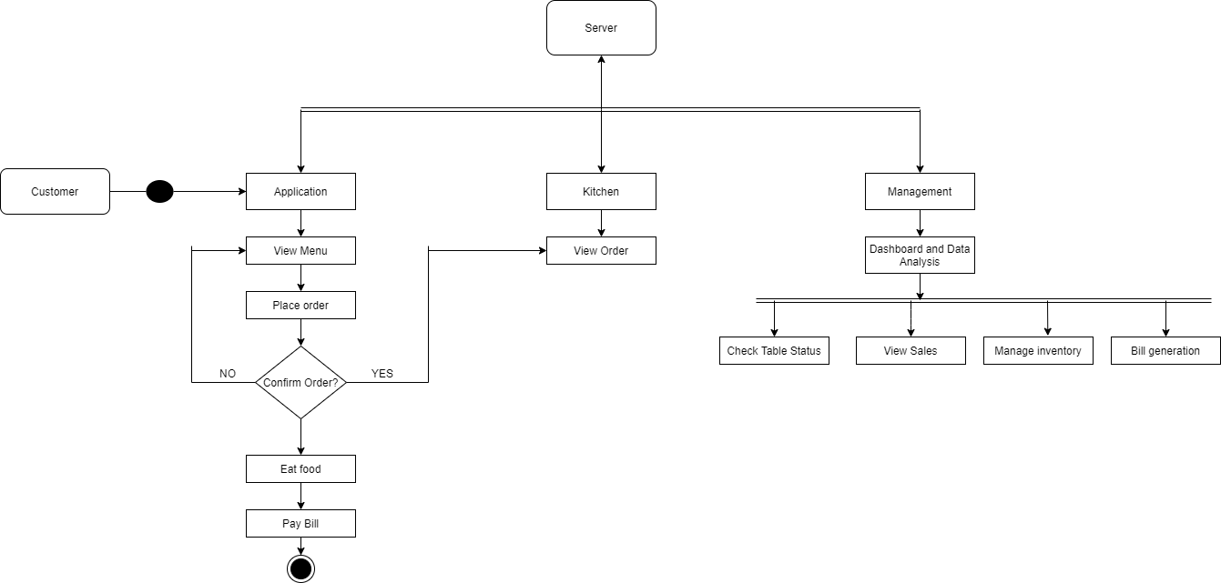
UML Diagram:

